Slide 1
Basics TensorFlow
Sungjoon Choi
(sungjoon.choi@cpslab.snu.ac.kr)

Slide 2
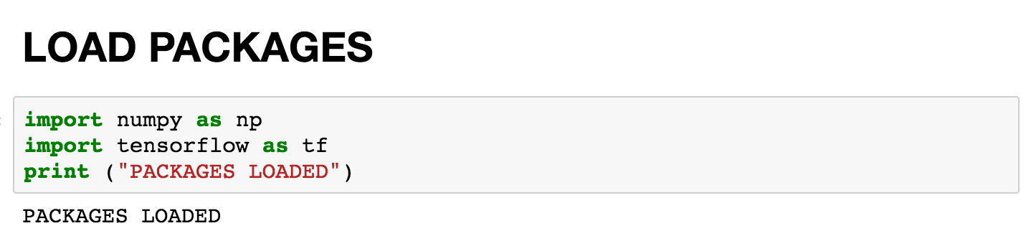
Notes:
import numpy as np
import tensorflow as tf
print ("PACKAGES LOADED")

Slide 3
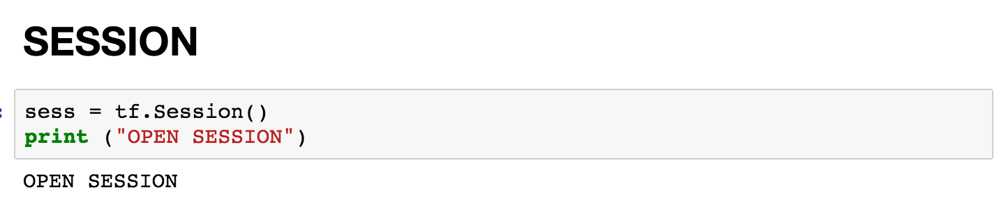
Notes:
sess = tf.Session()
print ("OPEN SESSION")

Slide 4
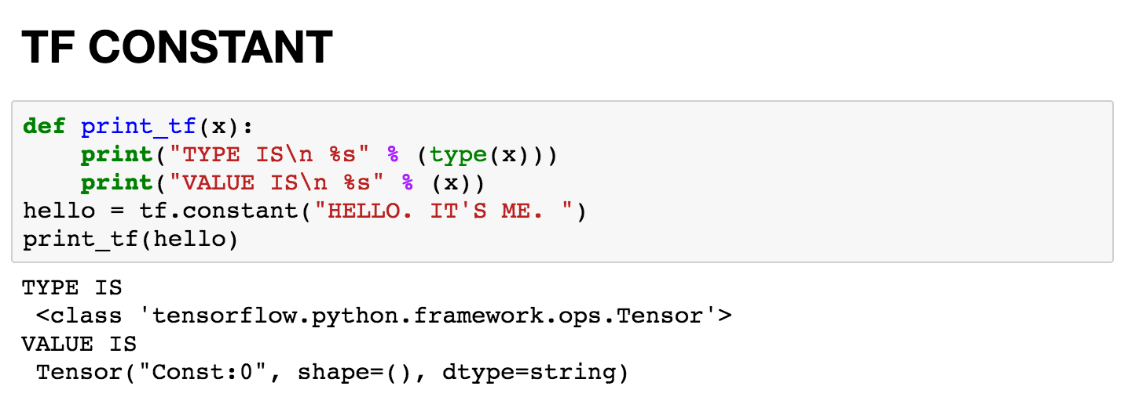
Notes:
def print_tf(x):
print("TYPE IS\n %s" % (type(x)))
print("VALUE IS\n %s" % (x))
hello = tf.constant("HELLO. IT'S ME. ")
print_tf(hello)

Slide 5
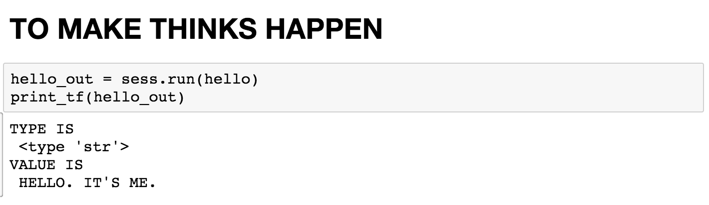
Notes:
hello_out = sess.run(hello)
print_tf(hello_out)

Slide 6
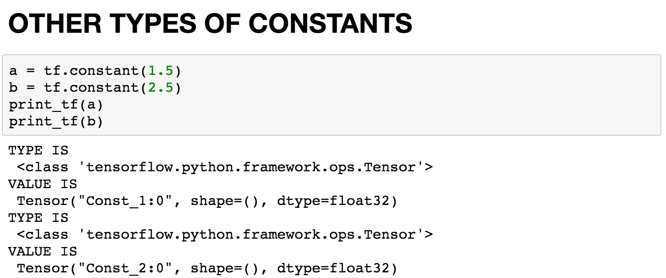
Notes:
a = tf.constant(1.5)
b = tf.constant(2.5)
print_tf(a)
print_tf(b)

Slide 7
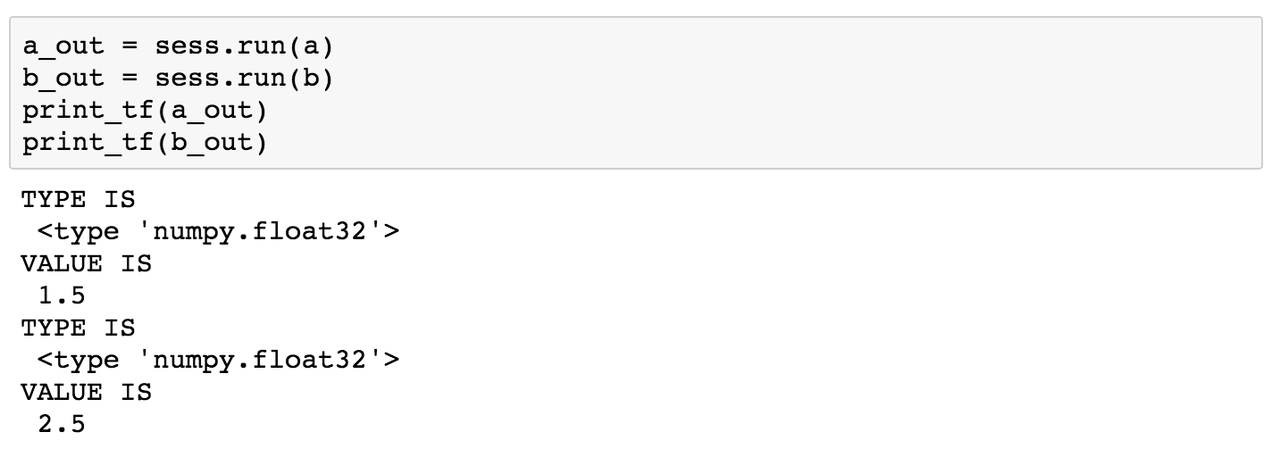
Notes:
a_out = sess.run(a)
b_out = sess.run(b)
print_tf(a_out)
print_tf(b_out)

Slide 8
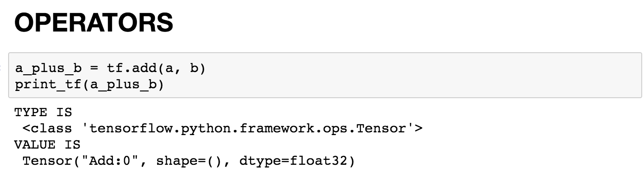
Notes:
a_plus_b = tf.add(a, b)
print_tf(a_plus_b)

Slide 9
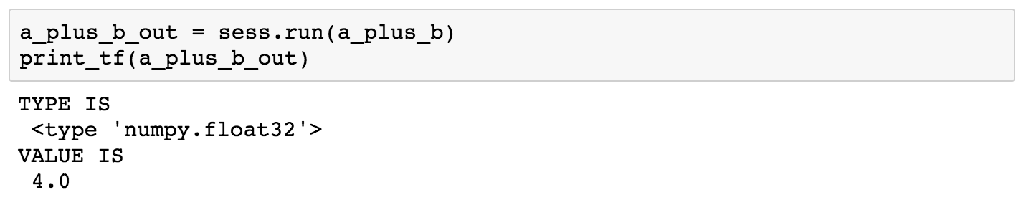
Notes:
a_plus_b_out = sess.run(a_plus_b)
print_tf(a_plus_b_out)

Slide 10
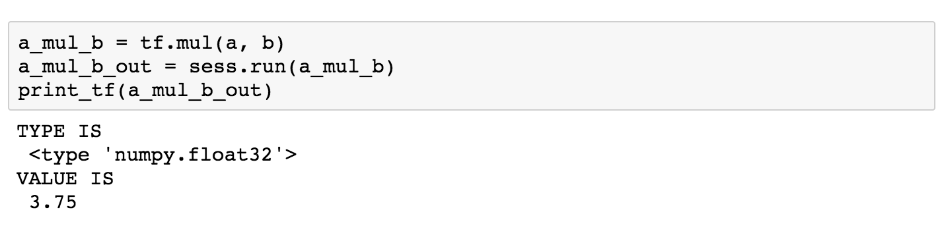
Notes:
a_mul_b = tf.mul(a, b)
a_mul_b_out = sess.run(a_mul_b)
print_tf(a_mul_b_out)

Slide 11
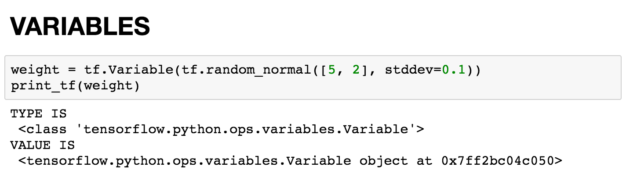
Notes:
weight = tf.Variable(tf.random_normal([5, 2], stddev=0.1))
print_tf(weight)

Slide 12
Notes:
weight_out = sess.run(weight)
print_tf(weight_out)

Slide 13
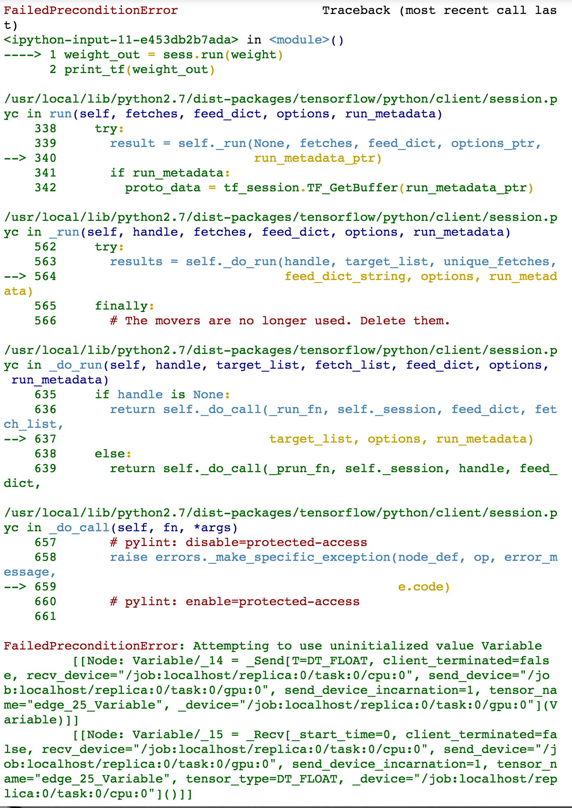

Slide 14
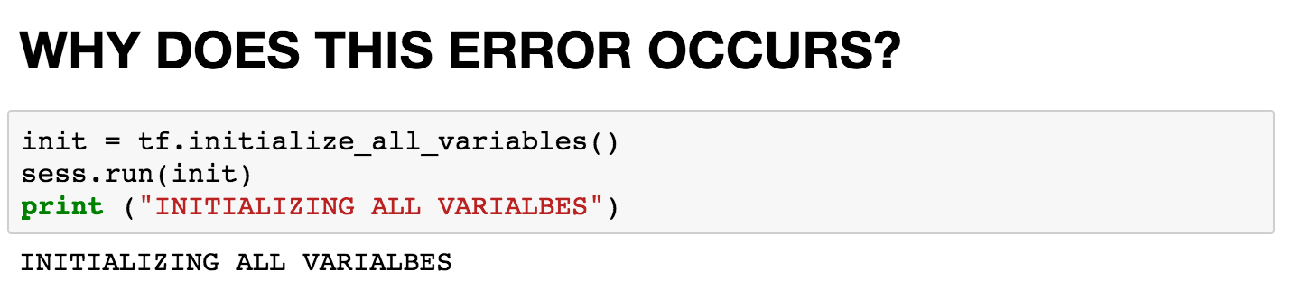
Notes:
init = tf.initialize_all_variables()
sess.run(init)
print ("INITIALIZING ALL VARIALBES")

Slide 15
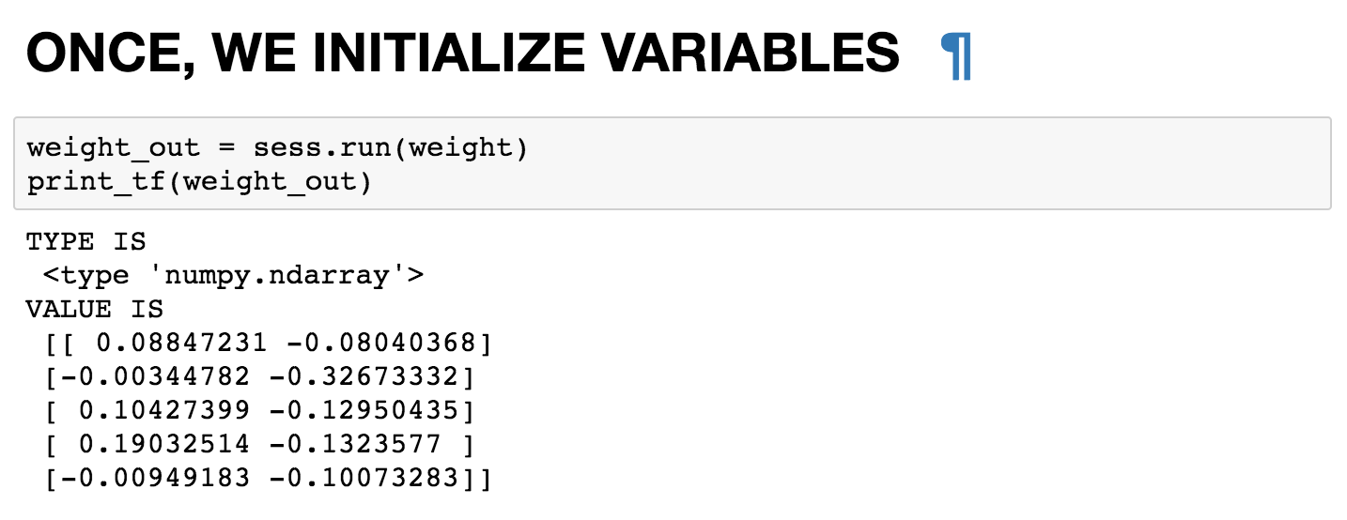
Notes:
weight_out = sess.run(weight)
print_tf(weight_out)

Slide 16
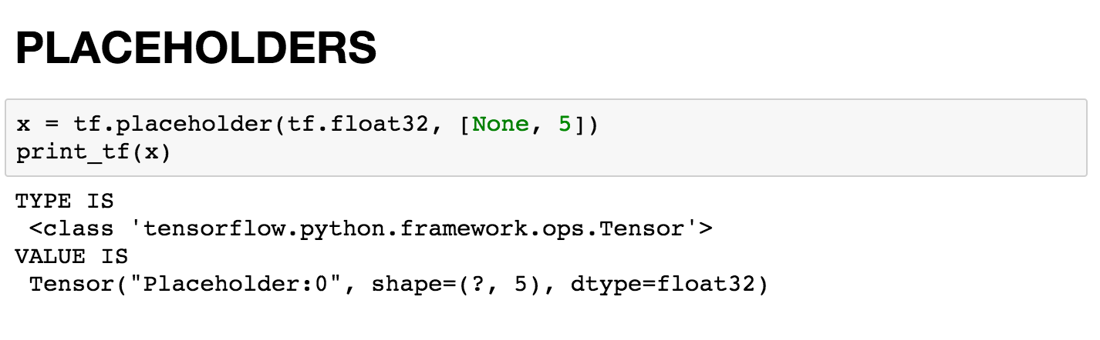
Notes:
x = tf.placeholder(tf.float32, [None, 5])
print_tf(x)

Slide 17
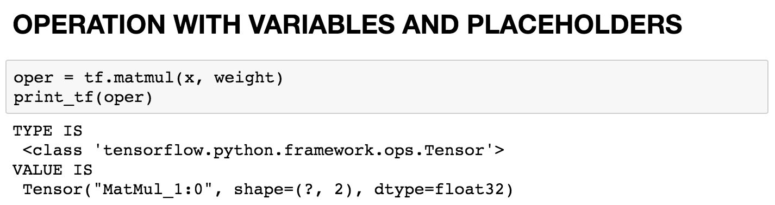
Notes:
oper = tf.matmul(x, weight)
print_tf(oper)

Slide 18
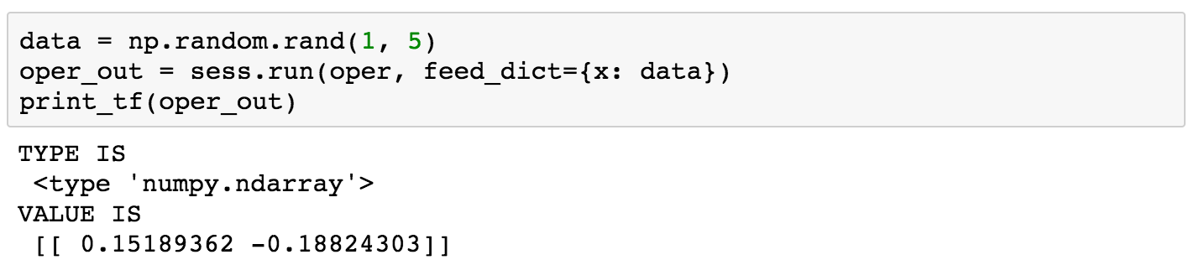
Notes:
data = np.random.rand(1, 5)
oper_out = sess.run(oper, feed_dict={x: data})
print_tf(oper_out)

Slide 19
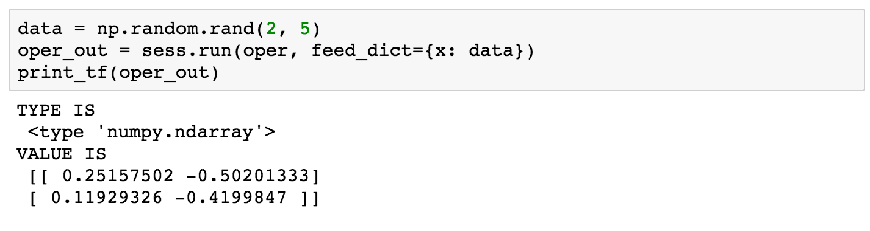
Notes:
data = np.random.rand(2, 5)
oper_out = sess.run(oper, feed_dict={x: data})
print_tf(oper_out)

